Slide 1

Methods and Classes
In Java, two or more methods within the same class can share the same name, as long as their parameter declarations are different.
When this is the case, the methods are said to be overloaded, and the process is referred to as method overloading.
Method overloading is one of the ways that Java implements polymorphism.

Slide 2
Methods and Classes
We must observe one important restriction: the type and/or number of the parameters of each overloaded method must differ.
It is not sufficient for two methods to differ only in their return types.
Of course, overloaded methods may differ in their return types, too.

Slide 3
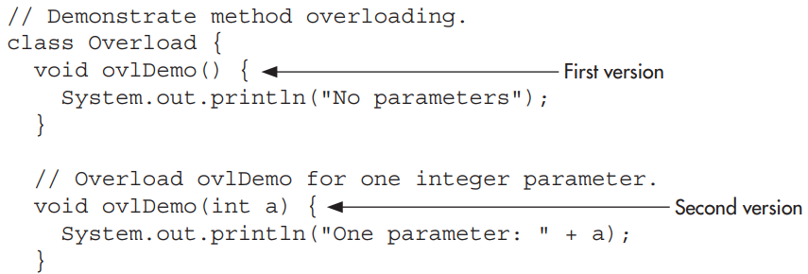
Methods and Classes
Here is a simple example that illustrates method overloading:

Slide 4
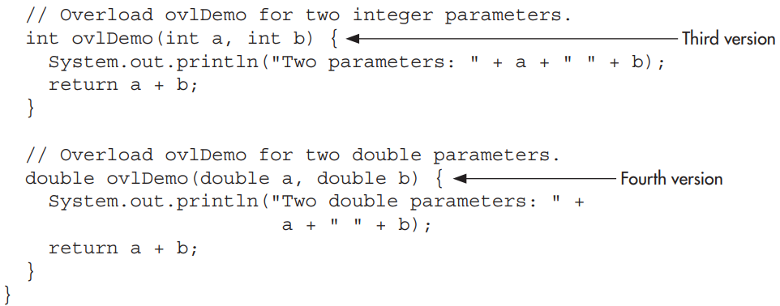
Methods and Classes

Slide 5
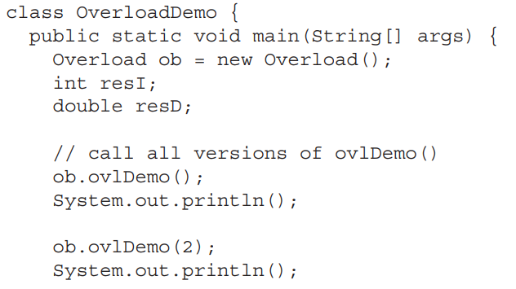
Methods and Classes

Slide 6
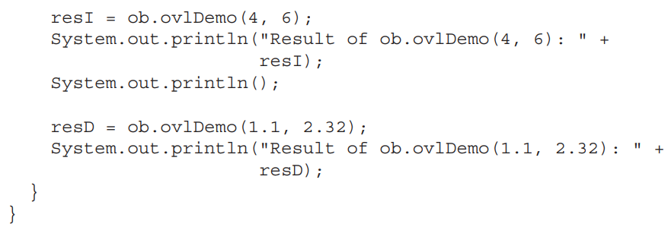
Methods and Classes

Slide 7
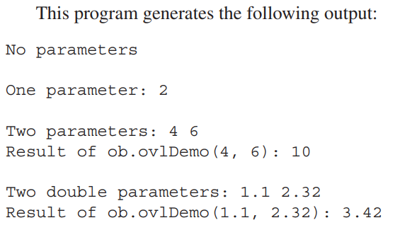
Methods and Classes

Slide 8
Methods and Classes
As we can see, ovlDemo( ) is overloaded four times.
The first version takes no parameters, the second takes one integer parameter, the third takes two integer parameters, and the fourth takes two double parameters.
Notice that the first two versions of ovlDemo( ) return void, and the second two return a value.
Overloading is not affected one way or the other by the return type of a method.

Slide 9
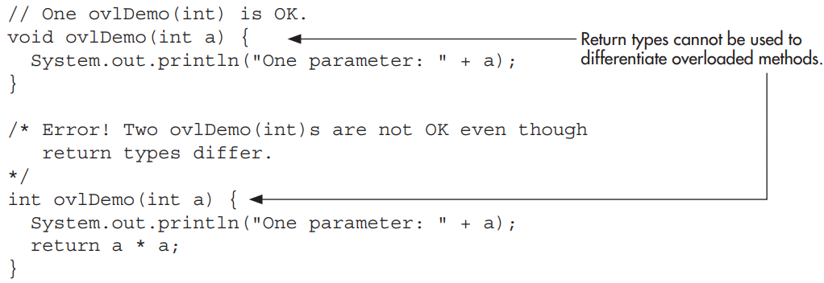
Methods and Classes
Thus, attempting to use the following two versions of ovlDemo( ) will cause an error.

Slide 10
Methods and Classes
As the comments suggest, the difference in their return types is insufficient for the purposes of overloading.

Slide 11
Methods and Classes
Java provides certain automatic type conversions. These conversions also apply to parameters of overloaded methods. For example, consider the following:

Slide 12
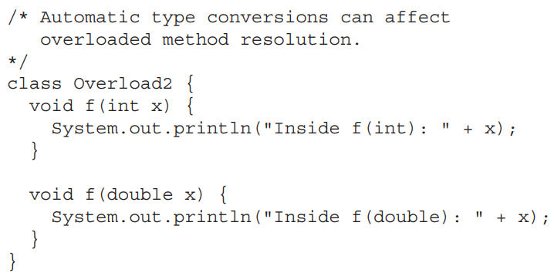
Methods and Classes

Slide 13
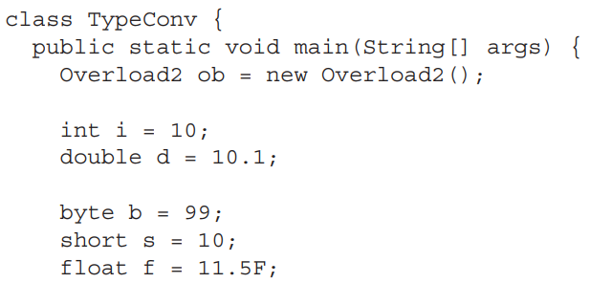
Methods and Classes

Slide 14
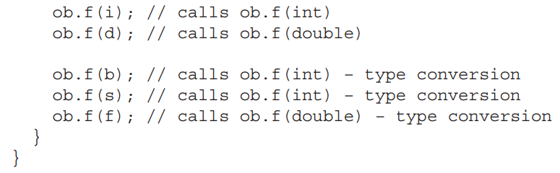
Methods and Classes

Slide 15
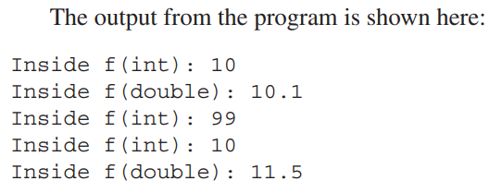
Methods and Classes

Slide 16

Methods and Classes
Like methods, constructors can also be overloaded.
Doing so allows we to construct objects in a variety of ways.
For example, consider the following program:

Slide 17
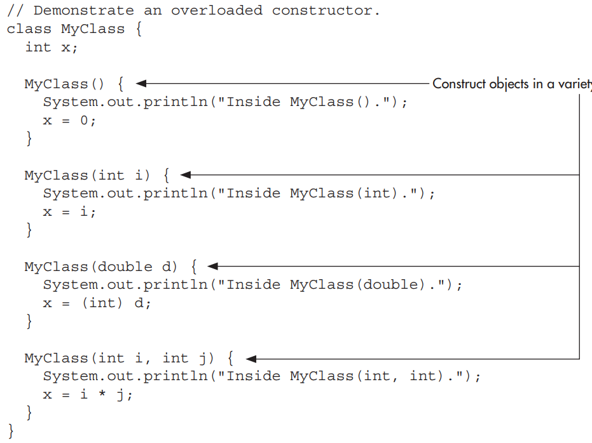
Methods and Classes

Slide 18
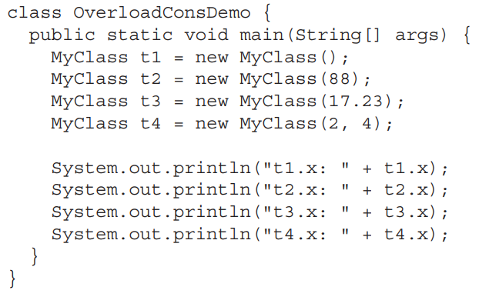
Methods and Classes

Slide 19
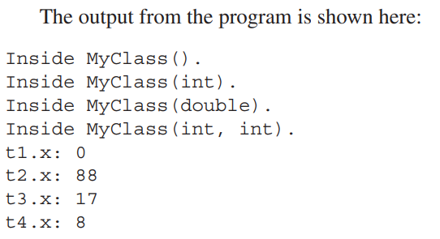
Methods and Classes

Slide 20
Methods and Classes
One of the most common reasons that constructors are overloaded is to allow one object to initialize another.
For example, consider this program that uses the Summation class to compute the summation of an integer value:

Slide 21
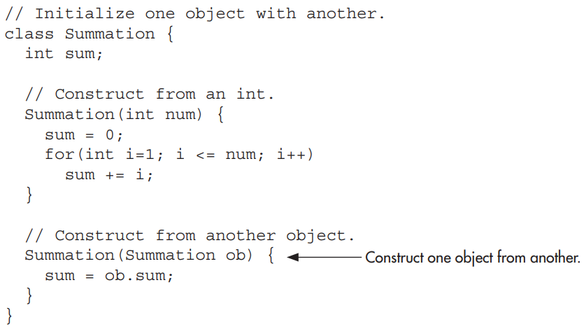
Methods and Classes

Slide 22
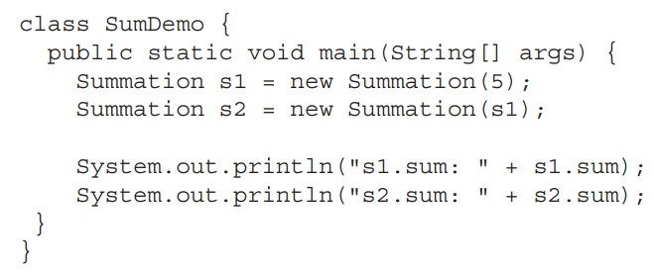
Methods and Classes

Slide 23
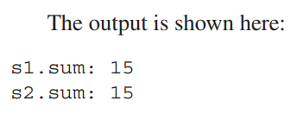
Methods and Classes

Slide 24

Methods and Classes
There will be times when you will want to define a class member that will be used independently of any object of that class.
Normally a class member must be accessed through an object of its class, but it is possible to create a member that can be used by itself, without reference to a specific instance.

Slide 25
Methods and Classes
To create such a member, precede its declaration with the keyword static.
When a member is declared static, it can be accessed before any objects of its class are created, and without reference to any object.
You can declare both methods and variables to be static.

Slide 26
Methods and Classes
The most common example of a static member is main( ).
main( ) is declared as static because it must be called by the JVM when your program begins.

Slide 27

Methods and Classes
Outside the class, to use a static member, you need only specify the name of its class followed by the dot operator.
No object needs to be created.
For example, if you want to assign the value 10 to a static variable called count that is part of the Timer class, use this line:

Slide 28
Methods and Classes
A static method can be called in the same way—by use of the dot operator on the name of the class.

Slide 29
Methods and Classes
Variables declared as static are, essentially, global variables.
When an object is declared, no copy of a static variable is made.
Instead, all instances of the class share the same static variable. Here is an example that shows the differences between a static variable and an instance variable:

Slide 30
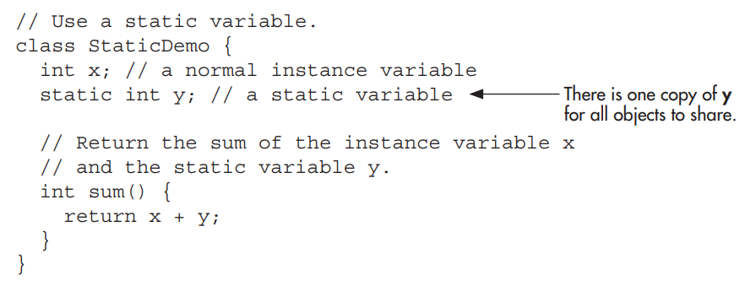
Methods and Classes

Slide 31
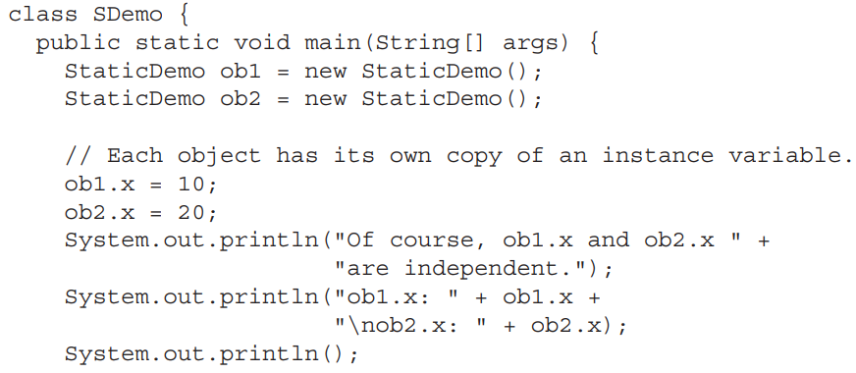
Methods and Classes

Slide 32
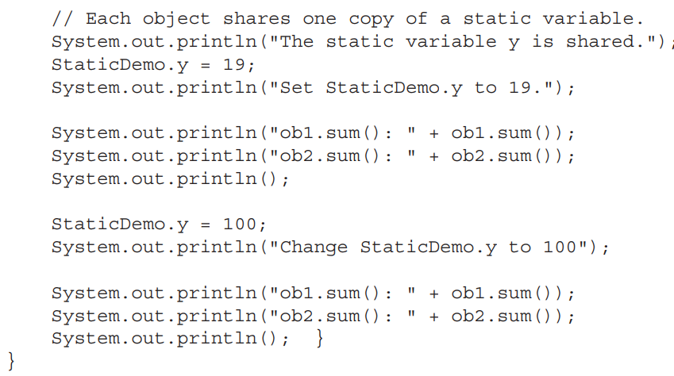
Methods and Classes

Slide 33
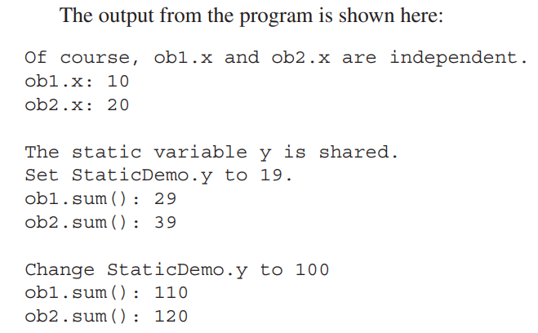
Methods and Classes

Slide 34
Methods and Classes
The difference between a static method and a normal method is that the static method is called through its class name, without any object of that class being created.
We have seen an example of this already:
the sqrt( ) method, which is a static method within Java’s standard Math class. Here is an example that creates a static method:

Slide 35
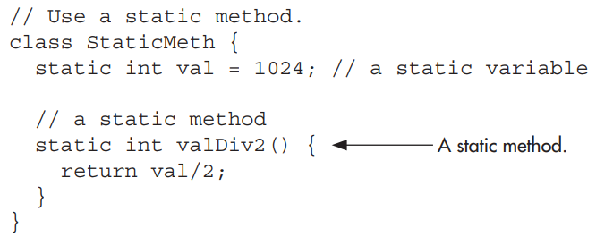
Methods and Classes

Slide 36
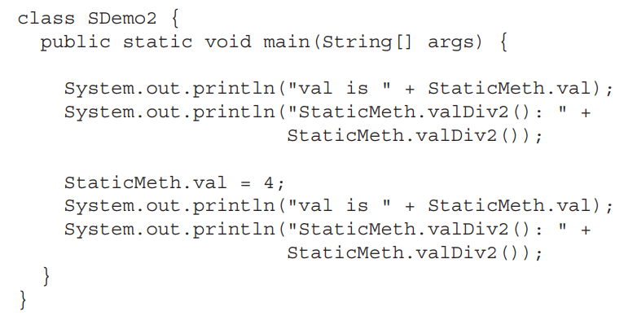
Methods and Classes

Slide 37
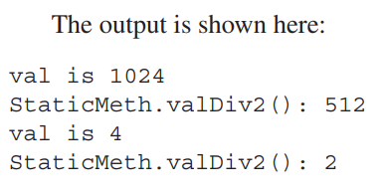
Methods and Classes

Slide 38
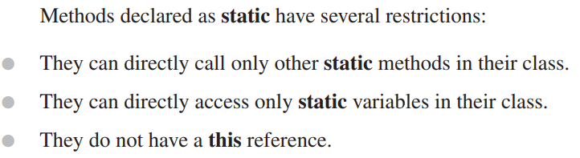
Methods and Classes

Slide 39
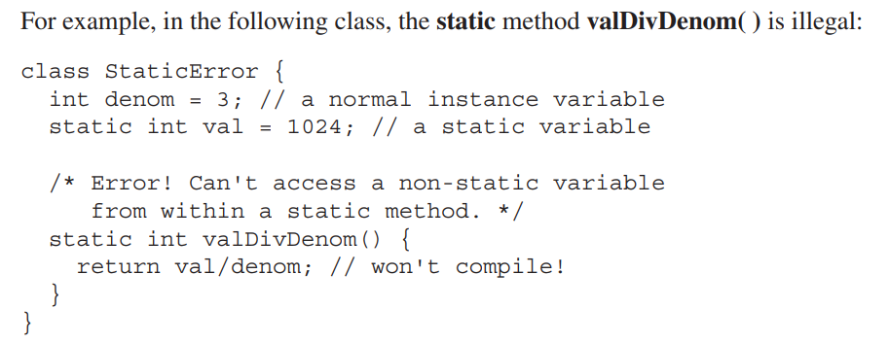
Methods and Classes

